Slide 1
Retrieving Geoinformation for Mountaineering: From Web Data to AI-Driven Insights
Franzelin Jean Patrick

Slide 2
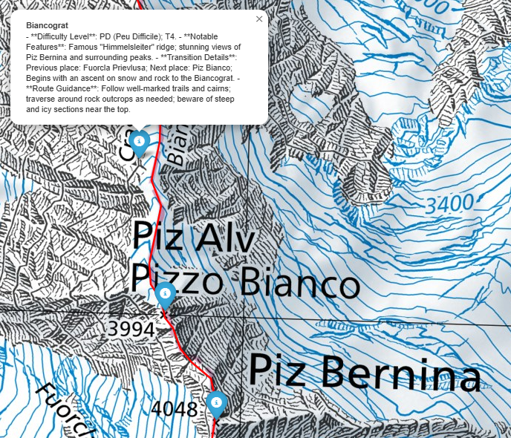
Introduction & Research Questions
Input:
Tour reports from Hikr.org
Output:
Important places on SwissTopo
AI-descriptions based on tour reports
Research questions:
Gathering and filter data
How can cartography enchance safty of specific risked person groups
AI and GIS for mountaineer
Notes:
How can descriptive text data be effectively gathered and converted into geospatial information for analysis and visualization?
What ethical considerations should be addressed when using web scraping to gather geoinformation from public sources?
Can the integration of text analysis, AI, and GIS improve the accessibility and usability of geoinformation for specific user groups, such as climbers or outdoor enthusiasts?

Slide 3
Ethics of Scraping
Ethical Problems
Consent and platform rules
Privacy concerns
Impact on platforms
(Krotov & Silva, 2020)
My Justifications
Educational purpose
Public data
Limited scope
Transparency
vs.
Krotov, V., & Silva, L. (2020). Legality and Ethics of Web Scraping. Communications of the Association for Information Systems, 47(1), Article 11. https://doi.org/10.17705/1CAIS.04711

Slide 4
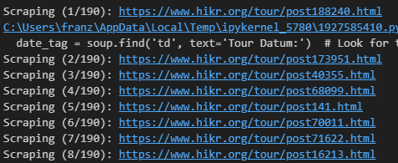
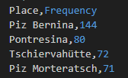
Methods
Web Scraping:
Html structure Hikr.org
Access individual links
Place Name Extraction:
Identify place names
E.g. peaks, huts, valleys

Slide 5
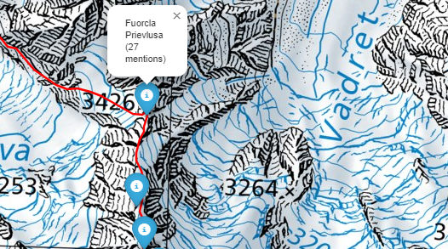
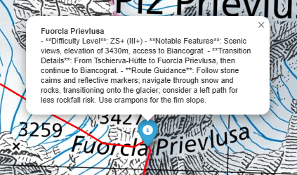
Methods
Geoparsing:
Geotagging -> points along GPX route
Plotted on Swiss Topo
Text Filtering:
Extracted text snippets
Text snippets -> OpenAI API (Python)
Climber-focused descriptions

Slide 6

What will my paper be about?
Enhanced safety through geoinformation visualization?
(Nevistić et al. 2019), (Le Coze et al., 2023) etc.
Web scraping method and ethics
Place name identification and geoparsing
AI-API summarization pro&cons

Slide 7
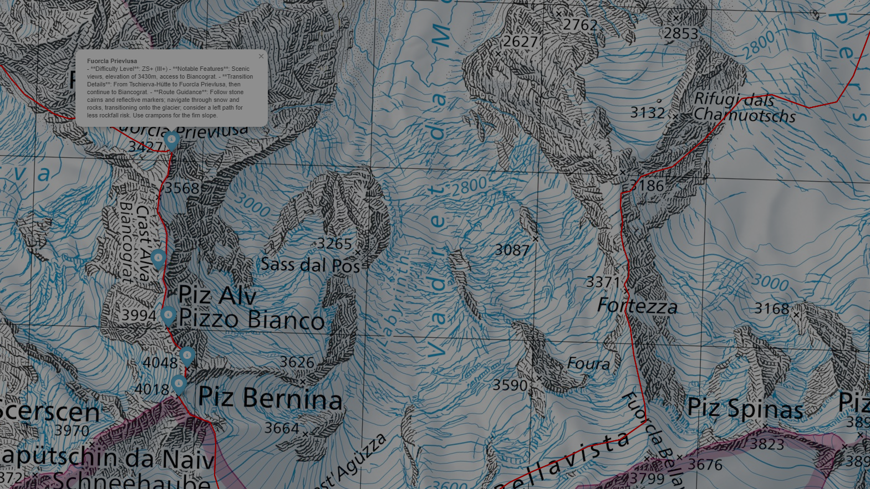

Thank you for your attention!
I’m open to your questions and feedback

